Slide 1
Welcome to this happy morning my dear students.
Class conducted by-
Md Hasan Hafizur Rahman
Senior Lecturer
Department of English
Cambrian School & College
Dhaka.
Class Nine
English 1st paper
Writing Part

Slide 3
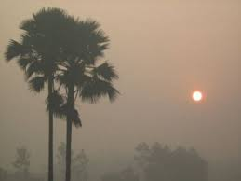
Let us see what our
Today’s Class is-
It is a paragraph
“Winter Morning”
From Writing part
English First paper

Slide 4
Aims of this lesson-
After we have studied this lesson we will be able to-
listen information
ask and answer questions
write a paragraph.

Slide 5
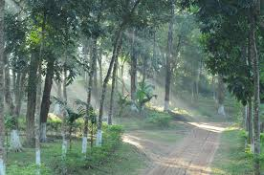
What is a winter morning?
What is a winter morning?
A winter morning is a morning of winter.

Slide 6
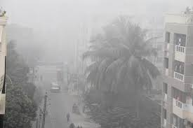
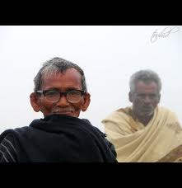
misty
cold
A winter morning is misty and cold.

Slide 7
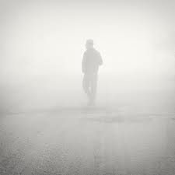
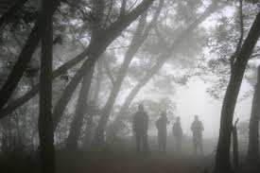
There is fog everywhere. Things at a little distance can hardly be seen.

Slide 8
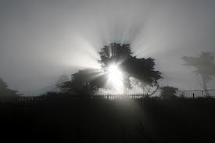
The sun seems to be rise late.

Slide 9
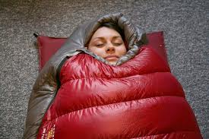
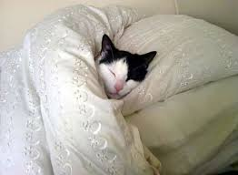
Everyone likes to stay in bed for a long time under quilt in the winter morning. It is very comfortable to all.

Slide 10
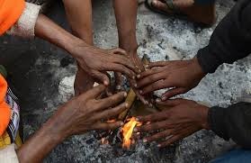
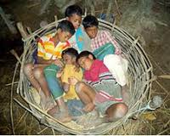
Poor people suffer much in the winter morning. They make fire to warm themselves.

Slide 11
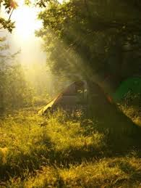
Very often poor people are seen enjoying the rays of the morning sun. It is really very enjoyable.

Slide 12
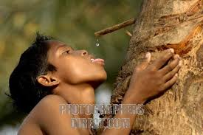
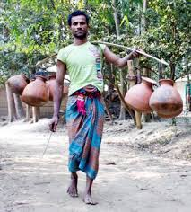
A winter morning is enriched with many delicious food. Fresh date juice is the main attraction of the winter morning.

Slide 13
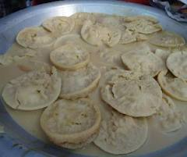
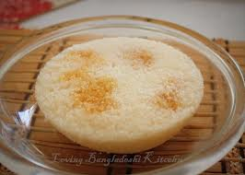
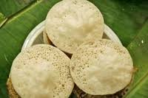
Juicey chitai pitha, dry chitai pitha, vapa pitha are the most interesting items of the winter morning.

Slide 14
Though a winter morning is somewhat painful, it is enjoyable.

Slide 15
Group Work

Slide 16
Evaluation
Answer the following questions:
What is a winter morning?
What do people like in a winter morning?
What do the poor do in a winter morning?
What is the main attraction of a winter morning?
What is your feeling of a winter morning?

Slide 17
Homework
Write a paragraph on
“A Winter Morning”

Slide 18
Verse Universal
Help the helpless

Slide 19
Bye bye
যাই যাই

